Slide 1
Bitemporal Data: making it happened in Postgres
Henrietta Dombrovskaya,
Chad Slaughter
Scale Genius, Inc.

Slide 2
Including time into data models
Why we may need to include time into our data model?
When was a change made? What exactly the change was? Was it an actual update or a correction of a mistake previously made?
How did the data look at some moment in the past? How the data will look at some moment in the future?
When did attribute X has value ‘a’? What was the value of attribute Y, when the value of attribute X was ‘a’?

Slide 3
I am skipping the list of temporal SQL researches
– we all know there were plenty!

Slide 4
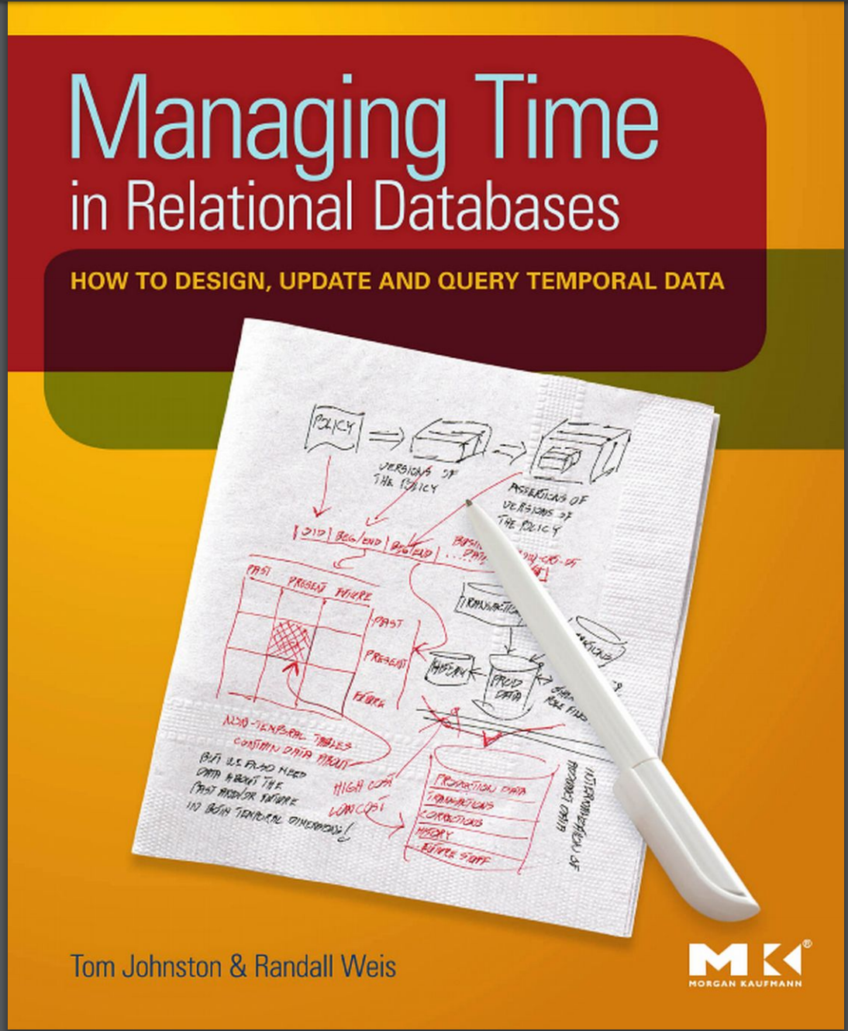
Asserted Versioning Framework
Johnson & Weis

Slide 5
Amazon reference
http://www.amazon.com/Managing-Time-Relational-Databases-Temporal/dp/0123750415/
The web site of the project:
http://assertedversioning.com/index.asp

Slide 6
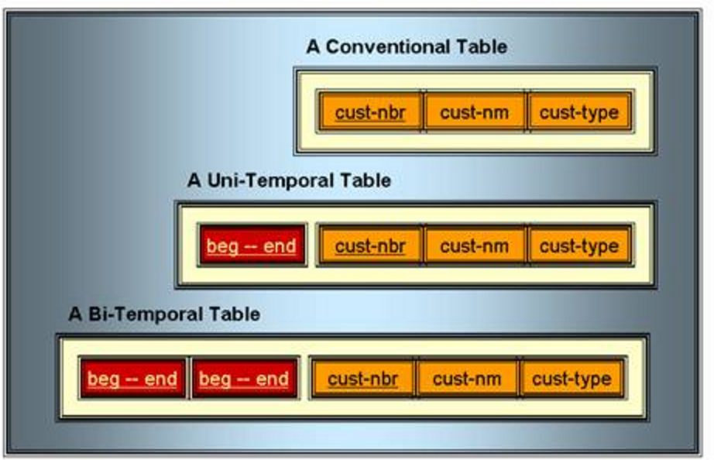
Conventional, Temporal and Bi-temporal tables

Slide 7
Next several slides represent examples
from the AVF project

Slide 8
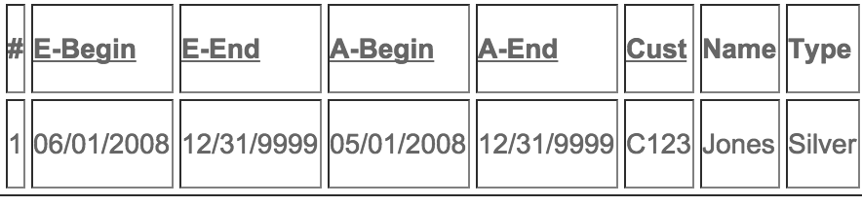
Bi-temporal insert

Slide 9
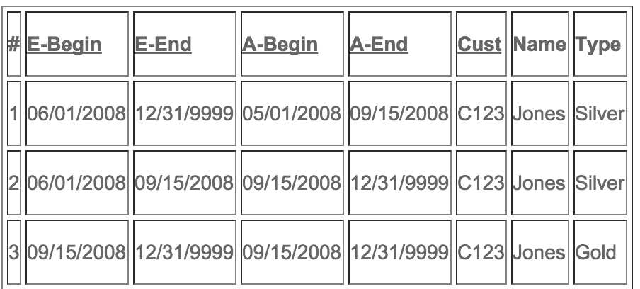
Bi-temporal update

Slide 10
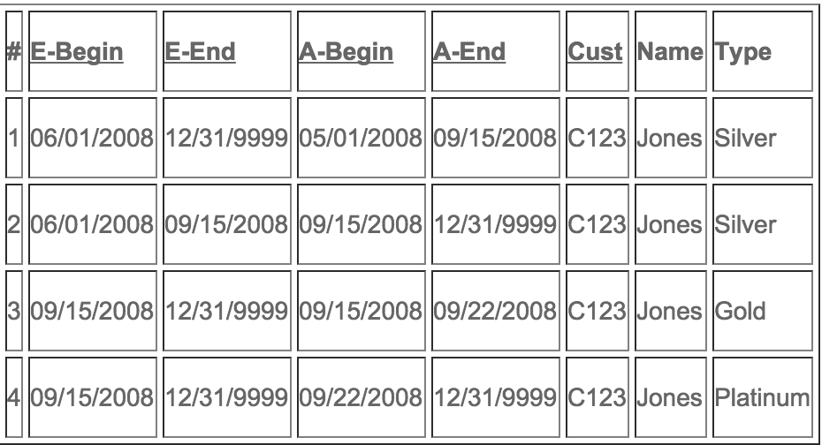
Bi-temporal correction

Slide 11
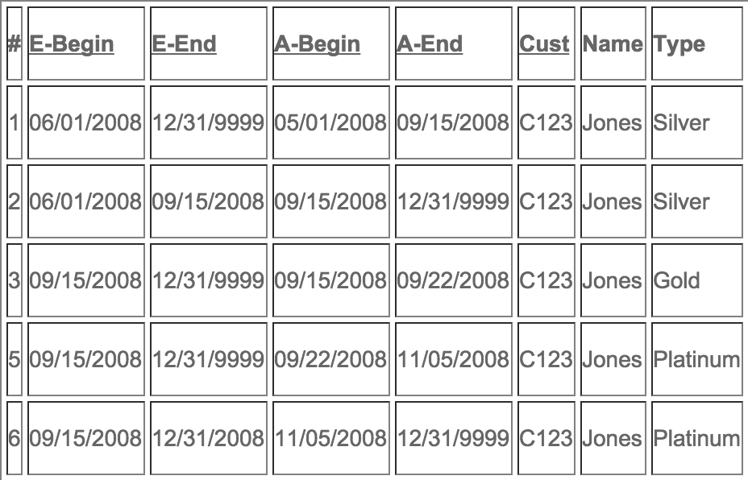
Bi-temporal deletion

Slide 12
Bi-temporal constraints
Temporal Entity Integrity (TEI) – the primary key and unique constraints for temporal tables are different – how?
Temporal Referential Integrity (TRI) – the foreign keys should be defined differently – how?

Slide 13
How to support bi-temporal data in PG 9.4
Ranges support and gist indexes makes it so easy!
CREATE TABE bi_temporal.customers(
cust-nbr INTEGER,
cust-nm TEXT,
cust-type TEXT,
effective_range TSRANGE,
asserted_range TSRANGE,
EXCLUDE USING gist (cust-nbr WITH =, effective_range WITH &&, asserted_range WITH &&))

Slide 14
Table example: database_version
CREATE TABLE database_versions(
release_version_key serial NOT NULL,
release_version_id integer,
release_version numeric(3,1),
effective temporal_relationships.timeperiod,
asserted temporal_relationships.timeperiod, row_created_at timestamp with time zone NOT NULL
DEFAULT now(),
CONSTRAINT release_version_id_asserted_effective_excl EXCLUDE USING gist
(release_version_id WITH =, asserted WITH &&, effective WITH &&)
)

Slide 15
Table example: postgres_clusters
CREATE TABLE bi_temp_tables.postgres_clusters(
postgres_cluster_key serial NOT NULL
,postgres_cluster_id integer NOT NULL
,port integer
,name character varying(16)
,postgres_version integer
,archive boolean NOT NULL DEFAULT false
,preferred_auth_method text
,effective temporal_relationships.timeperiod
,asserted temporal_relationships.timeperiod
,row_created_at timestamp with time zone NOT NULL DEFAULT now(), CONSTRAINT postgres_clusters_preferred_auth_method_fkey FOREIGN KEY (preferred_auth_method) REFERENCES bi_temp_tables.postgres_auth_methods (auth_method)
,CONSTRAINT postgres_cluster_id_asserted_effective_excl EXCLUDE USING gist (postgres_cluster_id WITH =, asserted WITH &&, effective WITH &&))

Slide 16
Repo:
https://github.com/scalegenius/pg_bitemporal

Slide 17
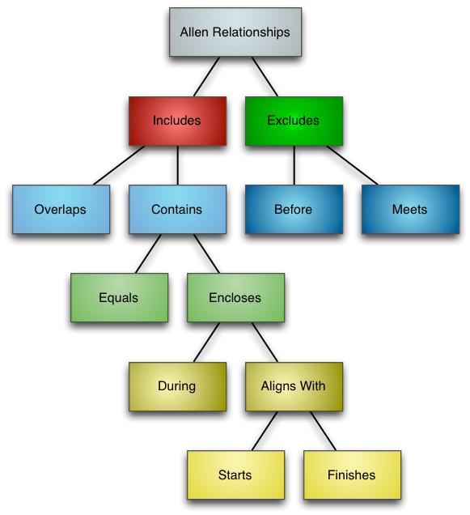
Allen Relationships

Slide 18
Functions representing Allen relationships
has_starts
has_finishes
equals
is_during
is_contained_in
has_during
is_overlaps
has_overlaps
is_before
is_after
has_before
is_meets
has_meets
has_includes
has_contains
has_aligns_with
has_encloses
has_excludes

Slide 19
Defining domains and ranges
create domain timeperiod as tstzrange;
create domain time_endpoint as timestamptz;
create or replace function timeperiod(
p_range_start time_endpoint,
p_range_end time_endpoint)
RETURNS timeperiodlanguage sql IMMUTABLE
as$func$
select tstzrange(p_range_start, p_range_end,'[)')::timeperiod;
$func$;

Slide 20
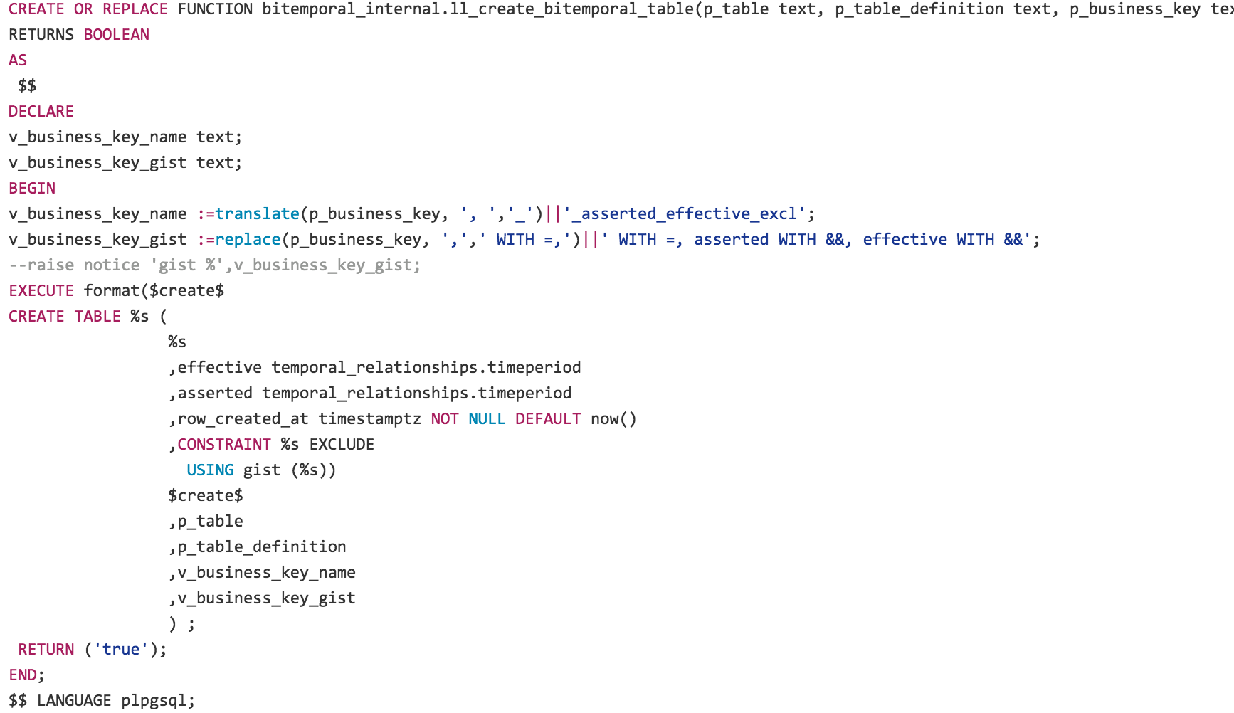
Create temporal table

Slide 21
Examples
select bitemporal_internal.ll_create_bitemporal_table(
'bi_temp_tables.database_versions’
,'release_version_key serial
,release_version_id integer --business key
,release_version numeric(3,1)' -- temporal unique
,'release_version_id’);
select bitemporal_internal.ll_create_bitemporal_table(
'bi_temp_tables.postgres_clusters’
,'postgres_cluster_key serial
,postgres_cluster_id integer NOT NULL
,port integer -- bitemporal unique
,name varchar(16)
,postgres_version integer -- bitemporal fk
,archive boolean DEFAULT false NOT NULL
,preferred_auth_method text references bi_temp_tables.postgres_auth_methods ( auth_method )'
,'postgres_cluster_id')

Slide 22
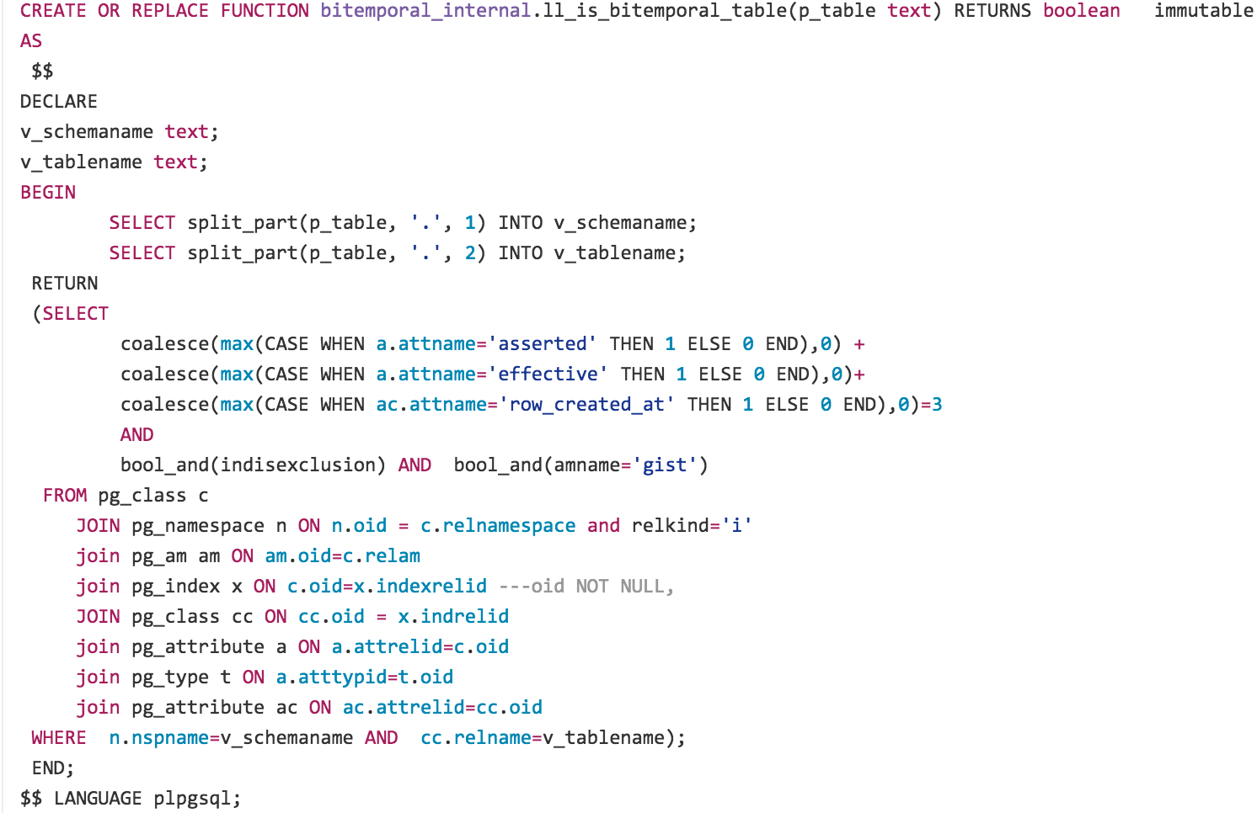
Check, whether the table in question is bitemporal

Slide 23
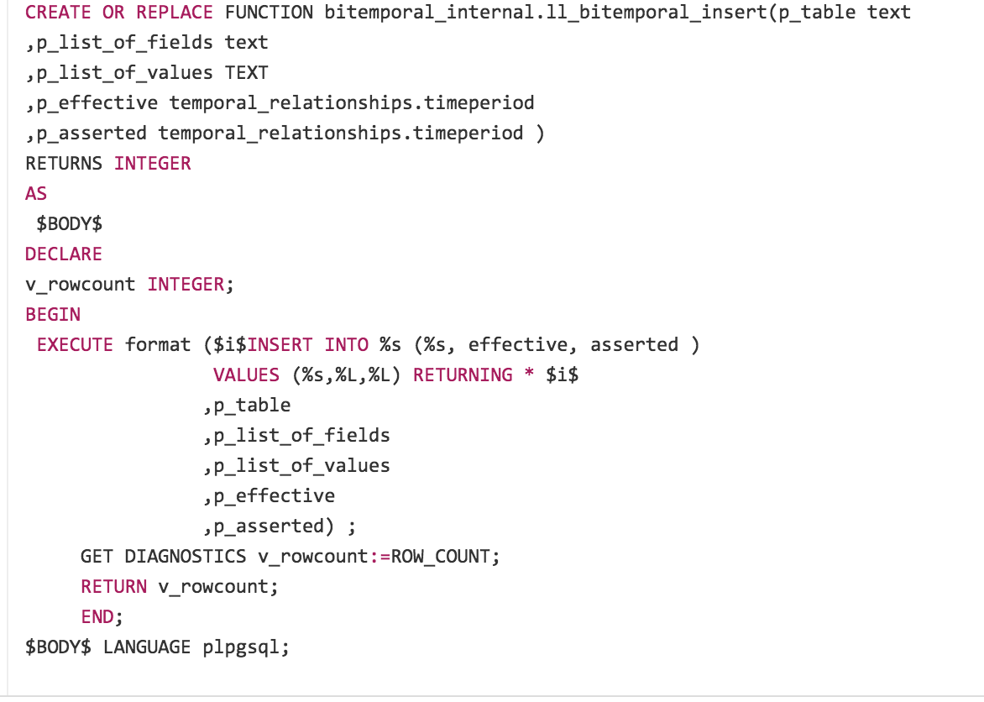
Bi-temporal insert

Slide 24
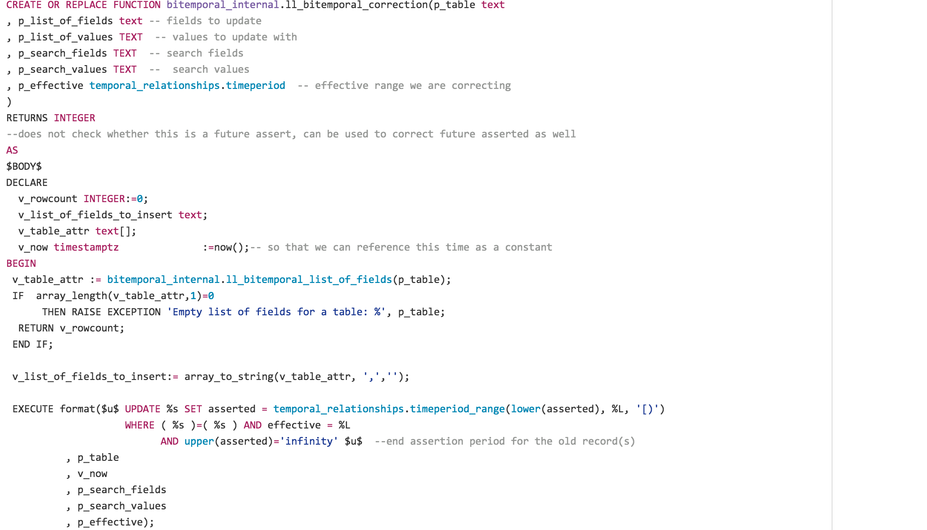
Bi-temporal correction

Slide 25
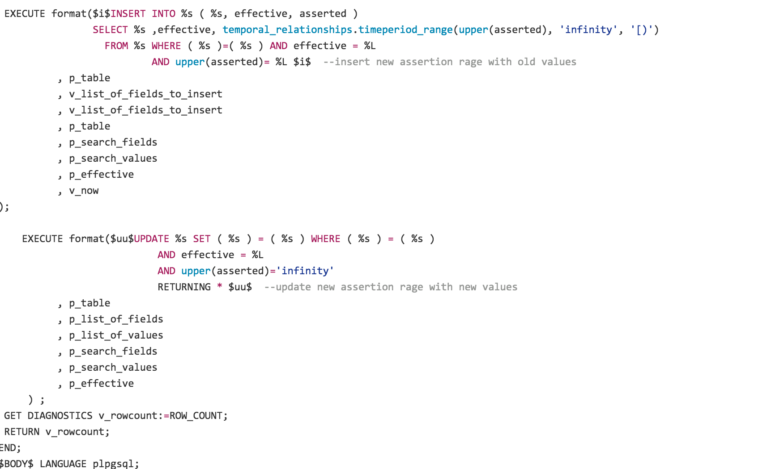

Slide 26
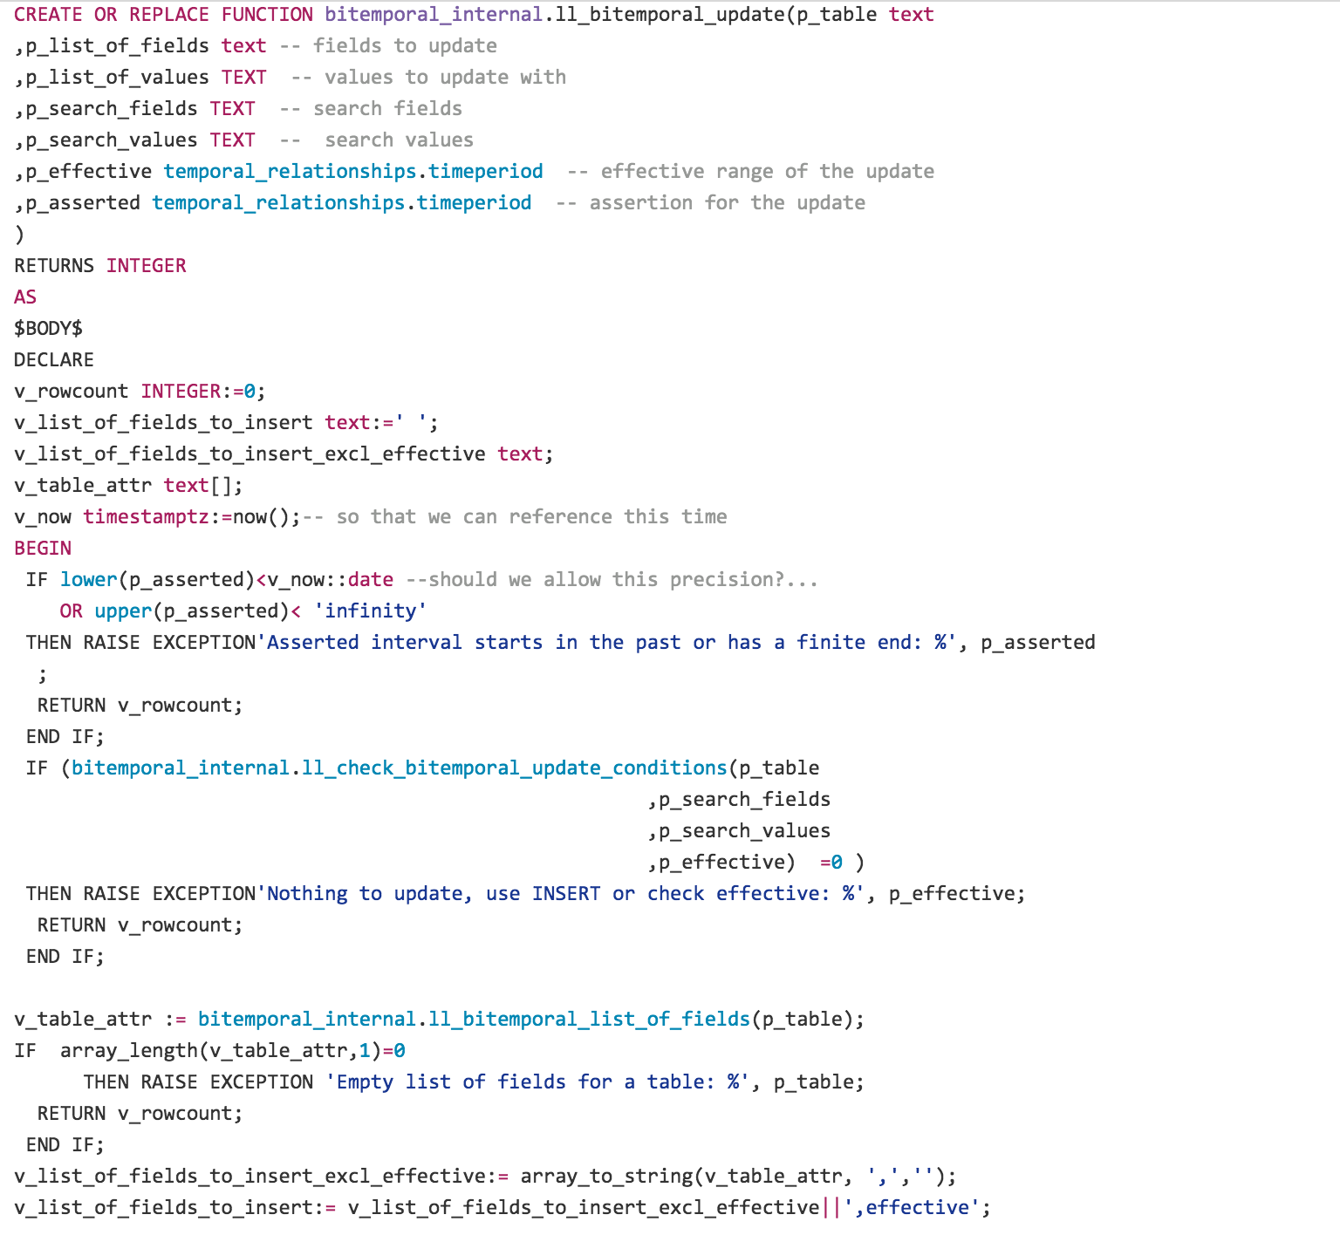
Bi-temporal update

Slide 27
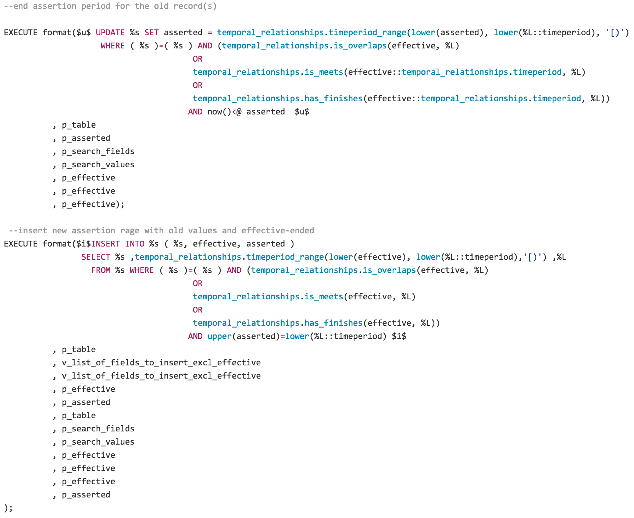

Slide 28
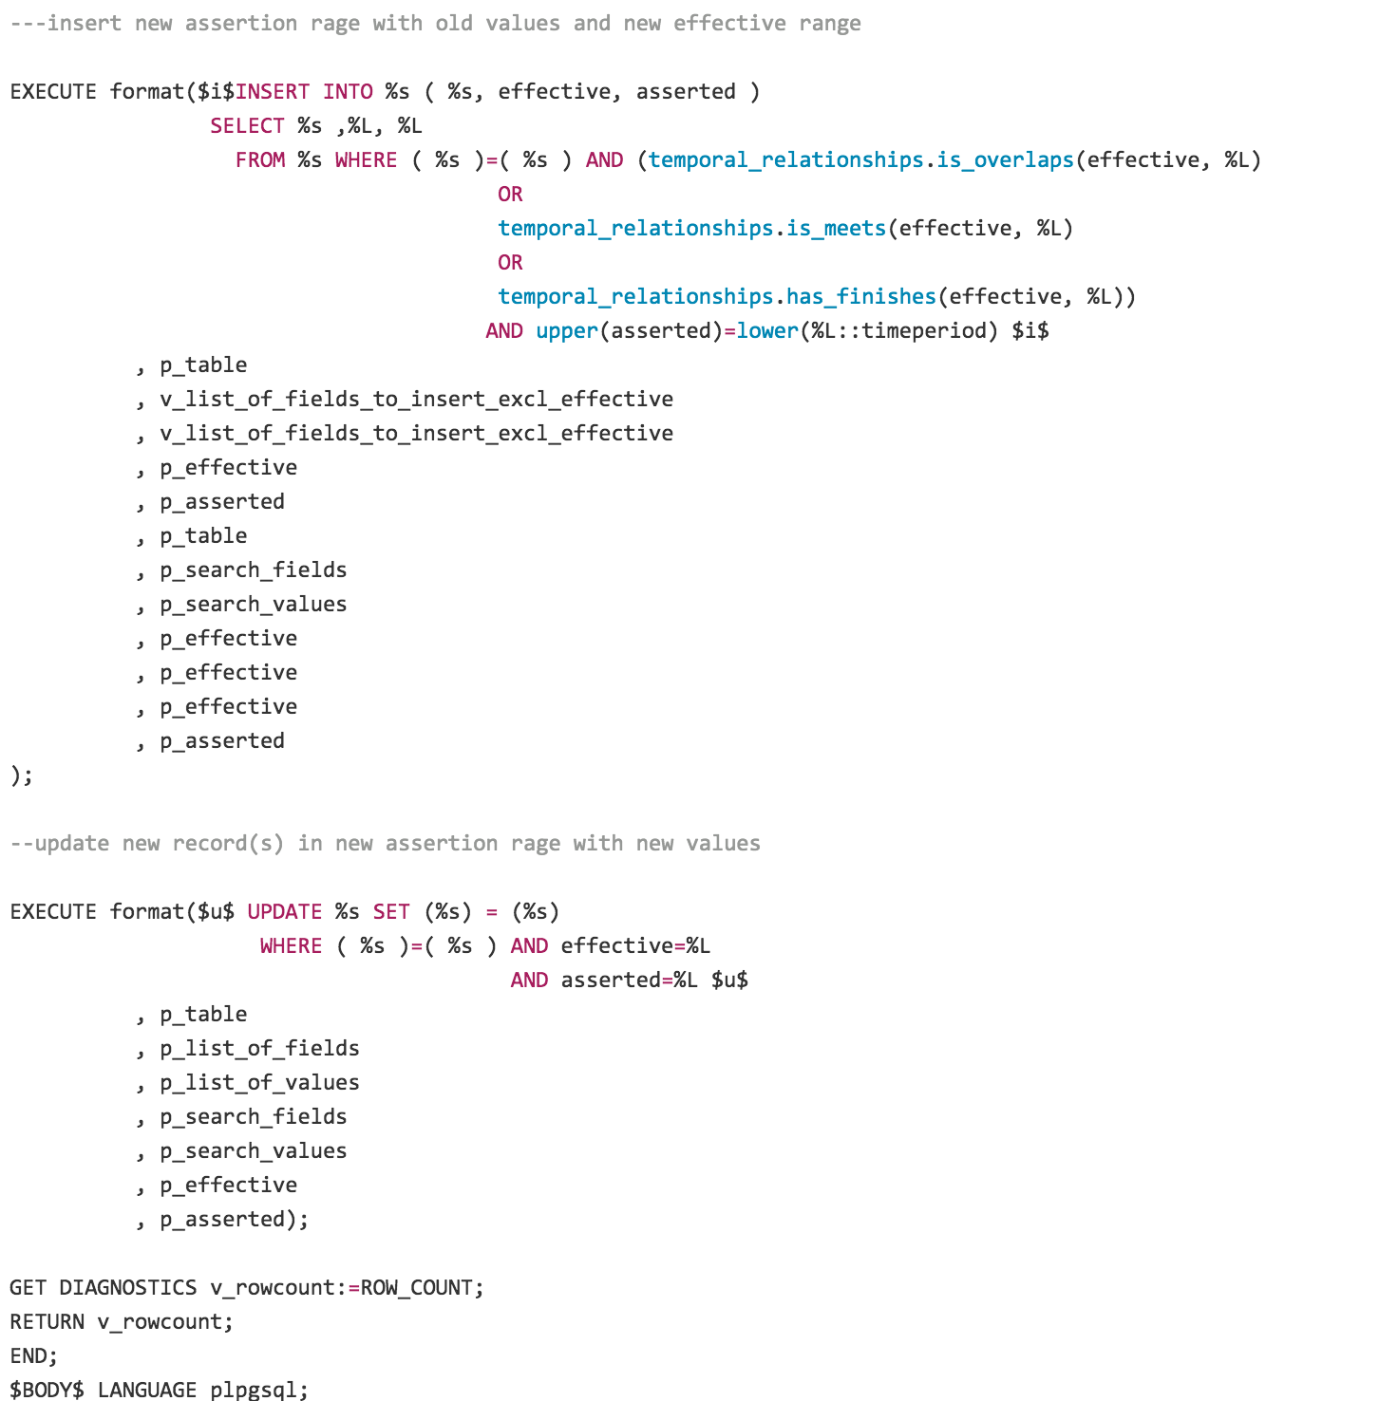

Slide 29
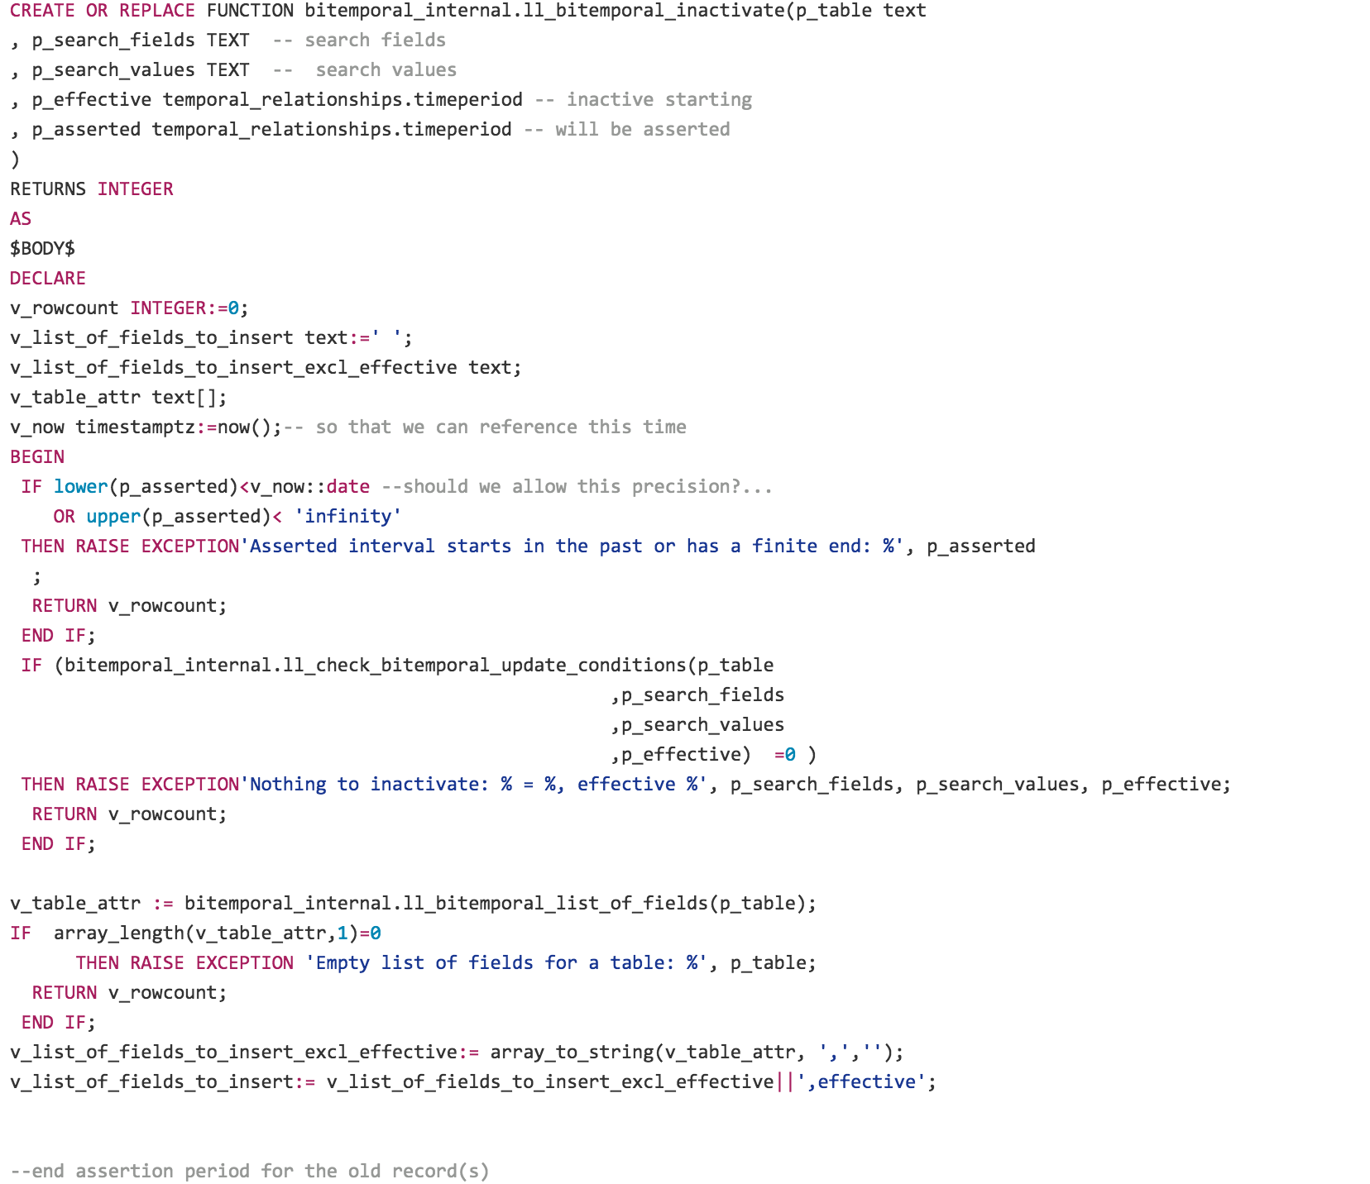
Bi-temporal inactivate

Slide 30
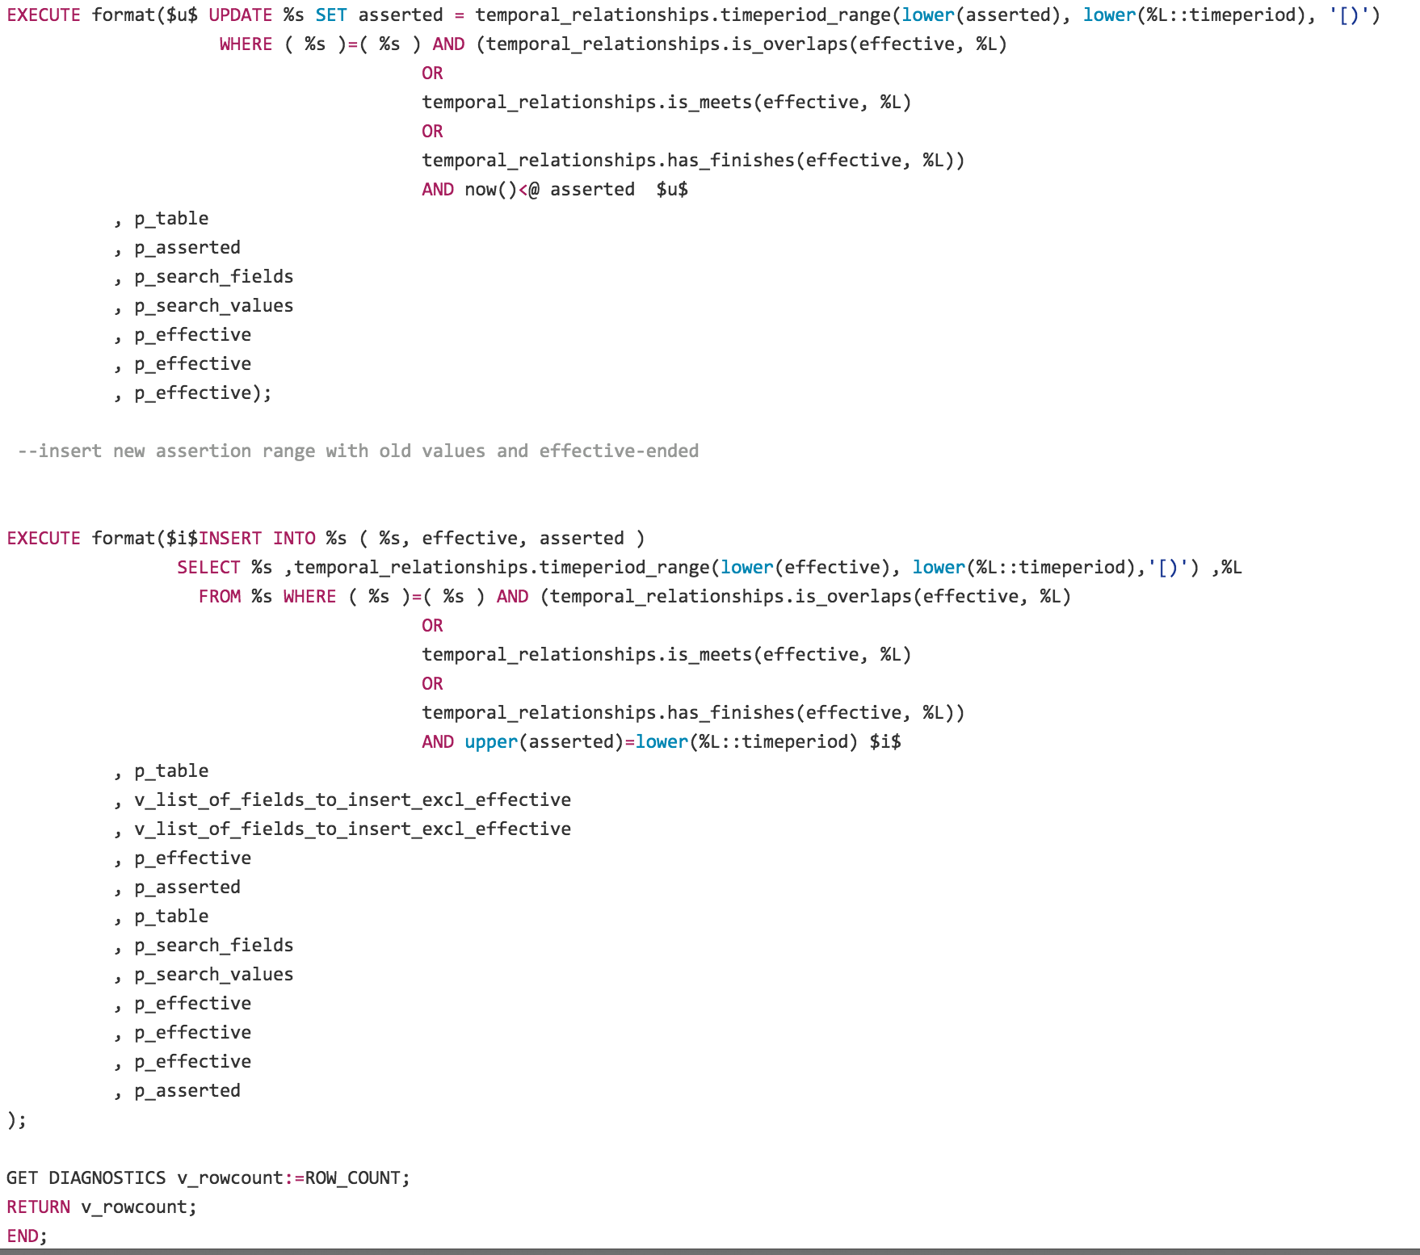

Slide 31
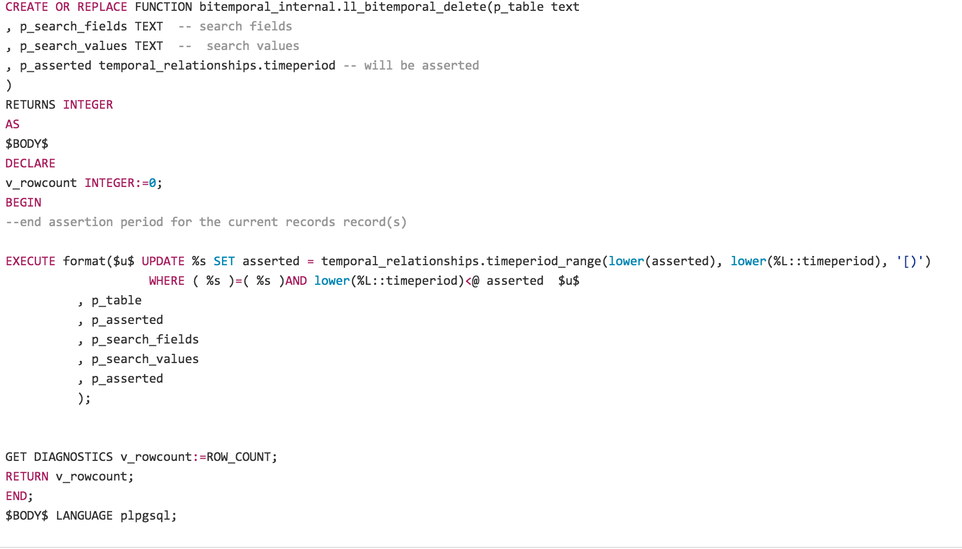
Bi-temporal delete

Slide 32
How to define constraints
We need to support the following constraint types:
  Primary key
  Unique
  Check – no difference from regular tables
  IS/IS NOT NULL – no difference from regular tables
  Foreign key
Metacode
  How we record the presence of the bitemporal constraints?

Slide 33
Define PK
We define a bitemporal primary key when we create a bitemporal table, i.e. there can’t be a temporal table without a bitemporal PK:
,CONSTRAINT postgres_cluster_id_asserted_effective_excl EXCLUDE USING gist (postgres_cluster_id WITH =, asserted WITH &&, effective WITH &&))
In addition we define a corresponding check constraint:
, CONSTRAINT "bitemporal pk postgres_cluster_id" check(true or 'pk' <> '@postgres_cluster_id@')
Function:
select bitemporal_internal.pk_constraint('postgres_cluster_id');

Slide 34
Define unique constraint
Defining unique constraint is no different from defining the PK, we just name them differently:
, CONSTRAINT "bitemporal unique port" EXCLUDE USING gist (port WITH =, asserted WITH &&, effective WITH &&)
In addition we define a corresponding check constraint:
CONSTRAINT "bitemporal unique port" EXCLUDE USING gist (port WITH =, asserted WITH &&, effective WITH &&)
Function:
select bitemporal_internal.unique_constraint('port');

Slide 35
Define foreign key constraint (bi-temporal referential integrity)
This is way more difficult, and that’s work in progress. That’s how it will look like:
CONSTRAINT "bitemporal fk postgres_version_database_versionsrelease_version" check (true or 'fk' <> '@postgres_version -> database_versions(release_version)@'));
Function:
select bitemporal_internal.fk_constraint( 'postgres_version', 'database_versions', 'release_version');

Slide 36
Future work
Bitemporal foreign keys full support
Finalizing low-level functions
Using in the real apps
Conversion to C.

